Slide 1
Living in the 21st Century
Global inflation and the rising costs of living

Slide 2
Blank slide
PROJECT Introduction
The living in the 21st Century project analyzes the rising costs of living across the globe. Examining inflation rates per country and the average price people pay for living expenses such as gas, housing and utilities.
The two datasets selected for this analysis were “Global Cost of Living” from Kaggle which provided the average consumer expense cost per city and “Global Database of Inflation” from the World Bank which contained inflation rates per year, per country until 2021.
These datasets were extracted, cleaned and loaded into PGAdmin SQL server. The merged datasets also needed coordinate information for mapping so an additional dataset with world coordinates was used to append to the file.

Slide 3
PROJECT VISUALIZATION TOOLS
Created a dashboard with interactive chart, table and choropleth map.
Used JS, HTML/CSS and plotly to create bar graph of countries inflation rates.
Used JS, HTML/CSS and leaflet to create an interactive choropleth map of countries inflation rates.
Used JS and HTML/CSS to create a table showing average costs per city across the globe.

Slide 4
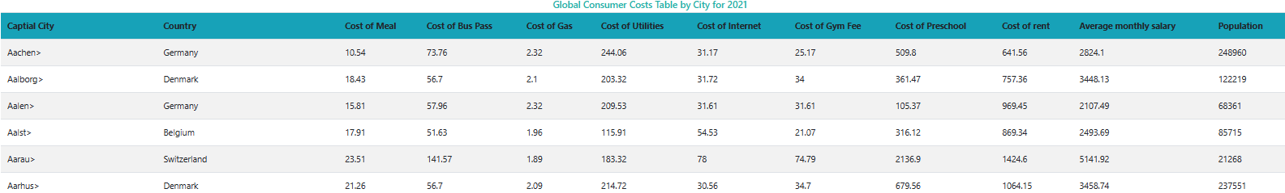
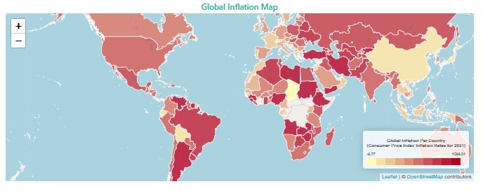
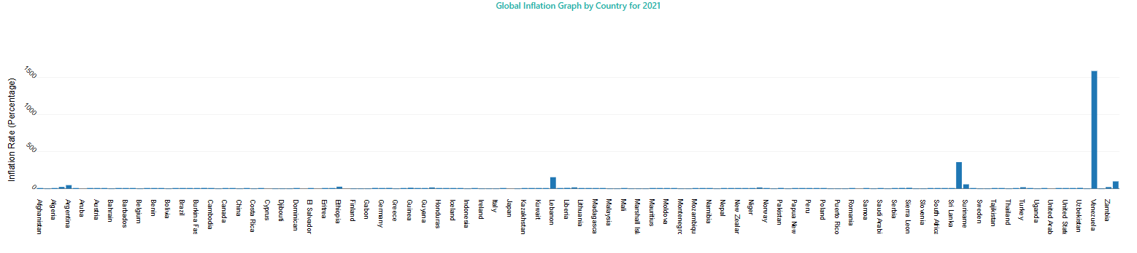
PROJECT VISUALIZATIONS

Slide 5
Datasets used for project
Global cost of living v2 - https://www.kaggle.com/datasets/mvieira101/global-cost-of-living
Global database of inflation - https://www.worldbank.org/en/research/brief/inflation-database
World Cities Database - http://simplemaps.com
Countries Database - https://gist.githubusercontent.com/erdem/8c7d26765831d0f9a8c62f02782ae00d/raw/248037cd701af0a4957cce340dabb0fd04e38f4c/countries.json

